Slide 1
Monte-Carlo Go Algorithm

Slide 2
A quick introduction to Go
Go-board: 19 × 19 intersections;
Black and White play alternatively. Black starts the game;
Adjacent stones are called a string. Liberties are the empty intersections next to the string;
Stones do not move, there are only added and removed from the board. A string is removed if its number of liberties is 0;
Score: territories (number of occupied or surrounded intersections).

Slide 3
Computer Go Difficulties
Comparison with chess
Chess: Deeper Blue won against Kasparov, 1997
Go: The strongest programs are about 10kyu in 2006
Huge branching factor about 200, while chess about 40
Legal positions number
2.0 × 10¹⁷⁰ on 19 × 19, 1.0 × 10³⁸ on 9 × 9
Good evaluation function difficult to build
Must take into account local, and global information

Slide 4
Computer Go Classical Methods
Combinatorial Game Theory (CGT)
  ONAG (Conway 1976),
  Winning ways (Conway & al 1982)
  Mathematical Go (Berlekamp 1991)
  Go as a sum of local games (Muller 1995)
Machine learning
  Automatic acquisition of tactical rules (Cazenave 1996)
  Neural network-based evaluation function (Enzenberger 1996)

Slide 5
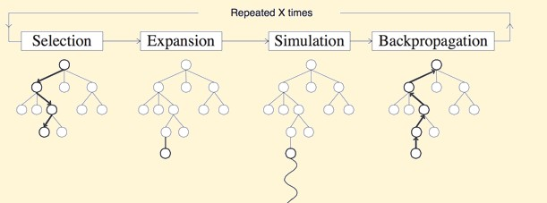
Naive Monte-Carlo Tree Search

Slide 6
Naive Monte-Carlo Tree Search
Montc-Carlo Evaluation:
Let p the position to evaluate;
From p, it plays against itself until the end of the game;
The final score is then allocated to p;
Possibly iterate and average.

Slide 7
Naive Monte-Carlo Tree Search

Slide 8
Benifits
Aheuristic:
Do not require any strategic knowledge about the given domain to make reasonable decisions
Complexity:
  Monte Carlo: O(NBL)
  Tree search: O(B^{L})
  N is the times of random games launched.
  B is the average branch factor.
  L is the average length of the game.

Slide 9
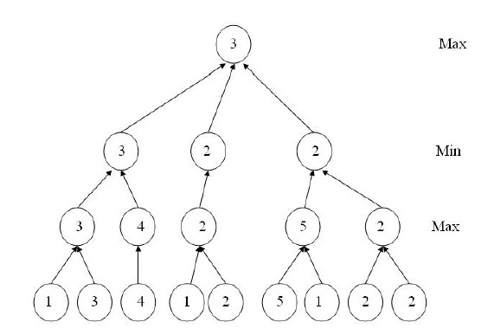
Minimax Tree

Slide 10
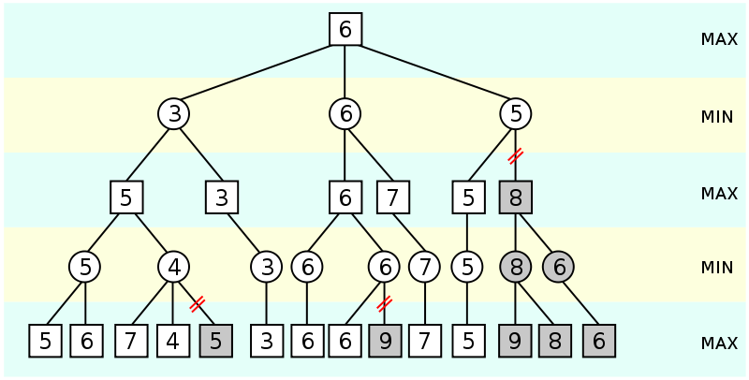
Alpha-Beta Pruning

Slide 11
Exploitation vs. Exploration
Exploitation of known rewards
Exploration of relatively unvisited nodes
Reward estimates are based on random simulations
Need time to become reliable

Slide 12

Using UCT
Upper Confidence Bounds (UCB) formula:
v_{i} the estimated value of the node
n_{i} the number of times the node being visited
N the total number of times its parent being visited
C a tunable parameter

Slide 13
Using UCT
start from the root;
until the end of the game:
choose a move according to UCB;
update the position.
score the game;
update all visited nodes with this score (without discount).

Slide 14
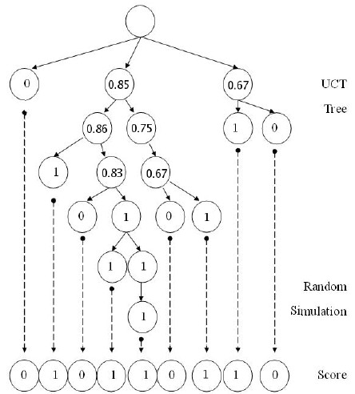
Using UCT

